Slide 1
Statistics for CSAI II 12 – Growth Curve Modeling/Mixed models
Travis J. Wiltshire |

Slide 2
Modules
Introduction and Probability
Sampling Theory
Revisiting Hypothesis Testing & Intro to Correlation
Correlation
Intro to Regression
More Regression Centering and Checking Assumptions
Multiple Regression and Assumptions
Interactions
Multiple Regression with Categories
Multiple Regression with Polynomials
Mixed Models
Growth Curve Analysis
2

Slide 3
Outline
What is it?
Example with modeling time with straight line
Adding polynomials
Orthogonal polynomials
Reporting
Graphing
Wrap up
2

Slide 4
Mixed Models and Growth Curve Modeling
Y_{si} = b_{0s} + b_{1s}X_{i} + … ε_{si}
^{b}0s ^{= b}0 ^{+ S}0s Random Intercept
Y_{si} = b_{0s} + b_{1s}Time_{i} + b_{2s}X_{i} +… ε_{si}
^{b}0s ^{= b}0 ^{+ S}0s Random Intercept
b_{1j} = b₁ + S_{1s}
b_{ns} = b_{n} + S_{ns}
Random Slopes
Random Slopes
Special case of mixed modeling
Focus on longitudinal designs
  i.e., repeated measures (time-series) data
Always includes Time (or another relevant continuous variable) as predictor (“Growth”)
Use polynomial regression to model different patterns of change over time (“Curve”)
  i.e., raising time to different polynomials
Used to model hierarchical/ nested/ clustered data
- Groups, cohorts, schools, organizations, hospitals, etc.
We can include fixed and random effects to predict an outcome variable

Slide 5
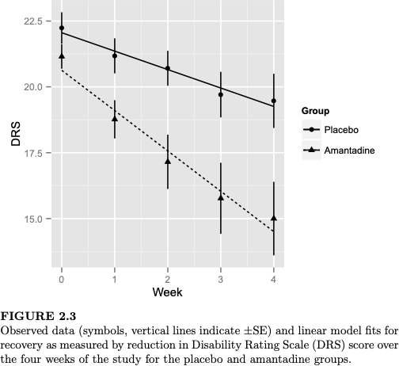
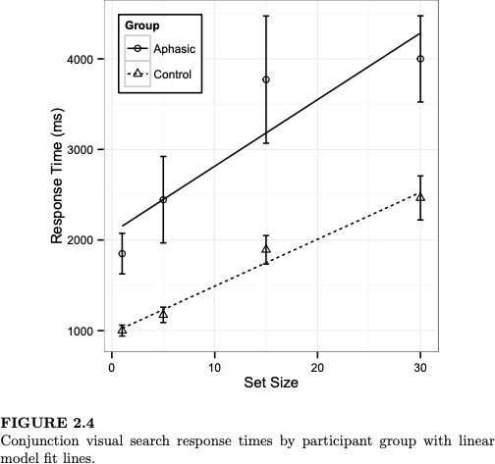
When to use Growth Curve Modeling
Figures from Mirman (2014)

Slide 6
Process of building growth curve models
Base model (unconditional) typically only includes:
  Outcome, time and random intercepts for the subjects
Next steps could include:
  adding polynomials for time (unconditional)
  adding variable of interest (conditional)
  adding an interaction term
  adding random slopes
  … and so on.
Including fixed effects and interaction terms captures (conditional) effects of variable of interest on how dependent variable changes over time.

Slide 7
Exercise 1: Run a series of growth models
Load the lme4 and lmerTest packages
Load the ChickWeight data:
  Load GrowthCurve_Examples.Rdata
  data(ChickWeight)
Check out the data set (look at data frame, get a summary, read the documentation)
Using lmer() make and save the following models. Be sure you understand what the models are testing before running them. And make some predictions about the tested relationships.
  weight ~ Time + (1|Chick), REML=F
  weight ~ Time + Diet + (1|Chick), REML=F
  weight ~ Time * Diet + (1|Chick), REML=F

Slide 8
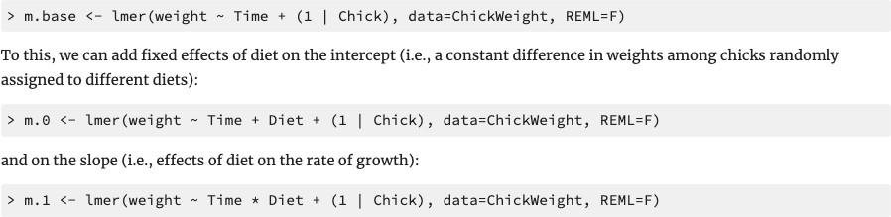
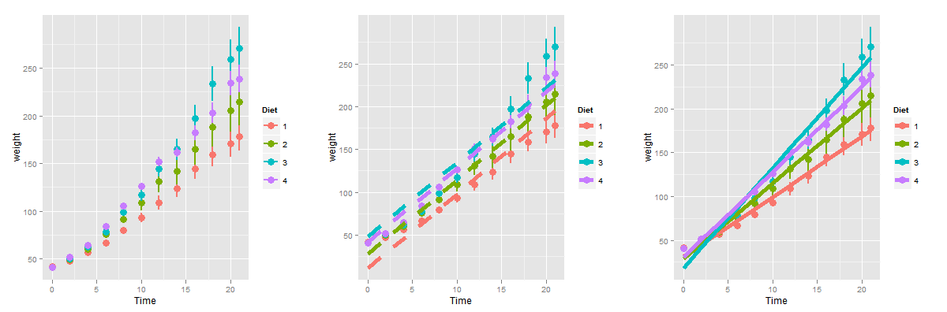
Example using ChickWeight data set
Start out from “base” model
https://www.danmirman.org/gca

Slide 9
Comparisons of model fit
Tend to rely on goodness of fit: log likelihood (LL)
Not very meaningful (unlike an R²)
Change in LL indicates improvement of the fit of the model (higher is better)
-2LL follows a chi square distribution (so we get p-values this way)
Can only compare nested models (dependent variable must be the same)
Check out this for more on LL and maximum likelihood estimation

Slide 10
Exercise 2: Compare fit of growth models
Use anova() to compare all three models (you can enter all three at once)
  You could also use test_performance() from the performance package
Generate a summary of the best fitting model and interpret
Now add the random slopes for Time to the model and compare it to your best fitting model from before
Check assumptions of the best fitting model
Try to make a plot of the best fitting model

Slide 11
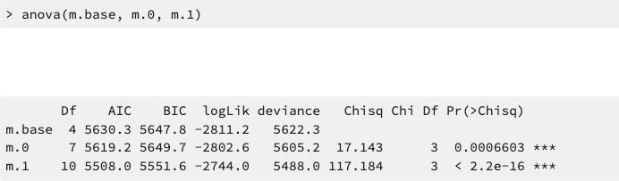
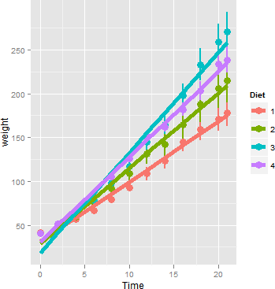
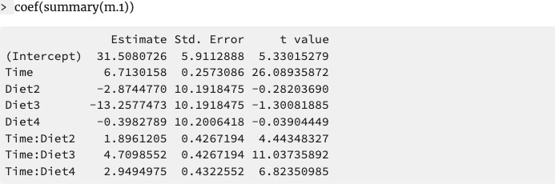
Example using ChickWeight data set (cont.)
Model comparison (change in goodness of fit; log likelihood)
https://www.danmirman.org/gca

Slide 12
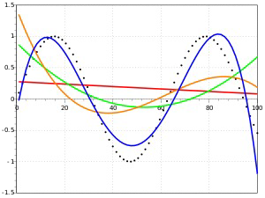
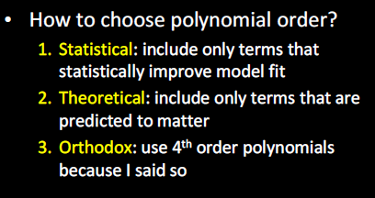
Functional form of growth curve
Polynomial patterns of change
  Function must be adequate for the shape of the data
  Dynamically consistency: The model of the average is equal to the average of the
individual models
Time
  Model any kind of curve shape
  Are not good at:
    capturing asymptotic behavior
    extrapolating from outside the observed time window

Slide 13
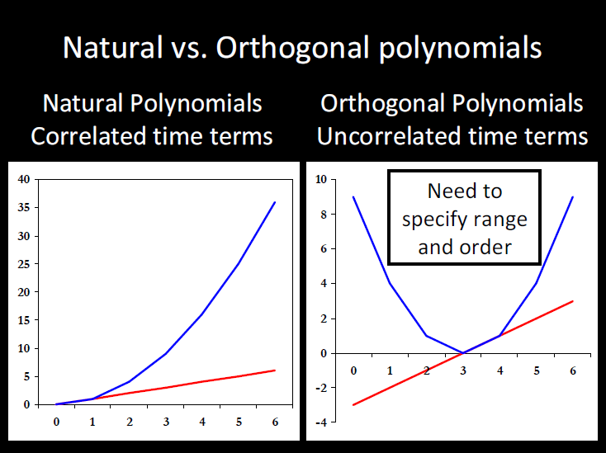
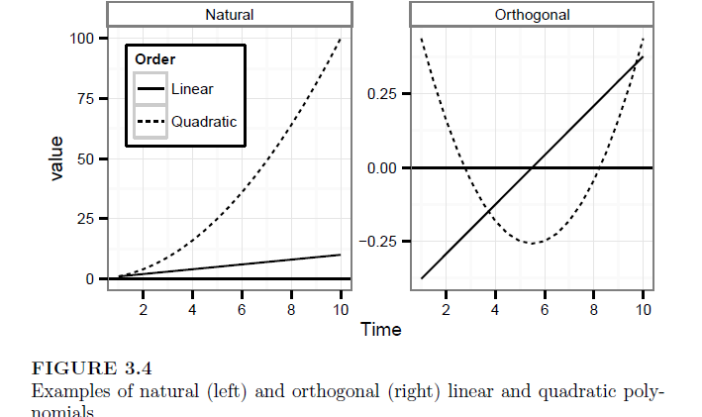
From Mirman, 2014

Slide 14
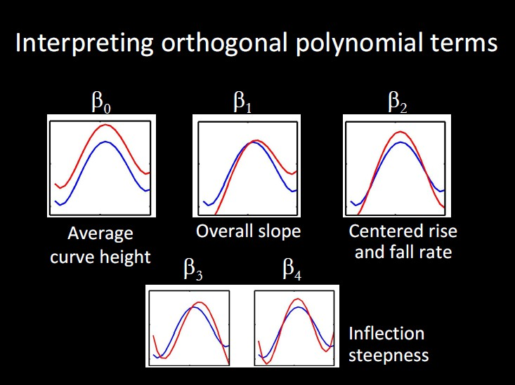

Slide 15
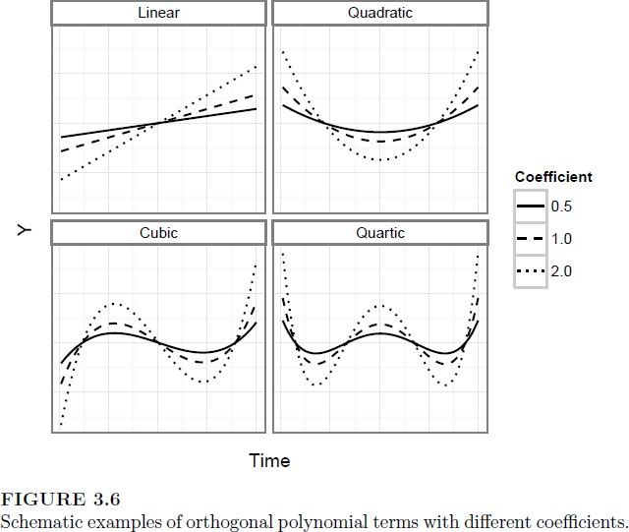
From Mirman, 2014

Slide 16
Specifying random effects
“Keep it maximal”
  When random effects are underspecified in growth models, more variance can get relegated to fixed effects than should be in terms of error.
  Try to include all possible random effects for the polynomials
  If model doesn’t converge, simplify the random effect structure (see Mirman, 2014 for ideas)

Slide 17
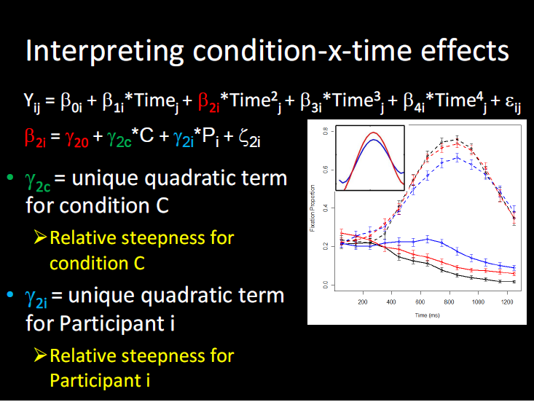

Slide 18
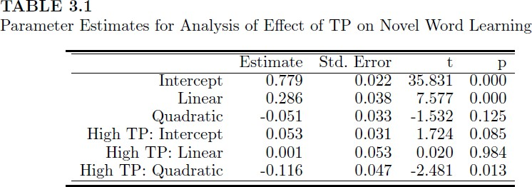
Reporting results from growth curve analysis
Must report form of model
  Types of polynomials, fixed effects, random effects
Main findings
  Report parameter estimates, standard errors, significance tests
Include a graph!
“Growth curve analysis (Mirman, 2014) was used to analyze the target gaze data from 300ms to 1000ms after word onset. The overall time course of target fixations was modeled with a third-order (cubic) orthogonal polynomial and fixed effects of Condition (Low vs. High frequency; within-participants) on all time terms. The model also included participant random effects on all time terms and participant-by-condition random effects on all time terms except the cubic (estimating random effects is “expensive” in terms of the number of observation required, so this cubic term was excluded because it tends to capture less-relevant effects in the tails). There was a significant effect of Condition on the intercept term, indicating lower overall target fixation proportions for the Low condition relative to the High condition (Estimate = -0.058, SE = 0.019, p < 0.01). There was also a significant effect on the quadratic term, indicating shallower curvature - slower word recognition - in the Low condition relative to the High condition (Estimate = 0.16, SE = 0.054, p < 0.01). All other effects of Condition were not significant (see Table 1 for full results).”

Slide 19
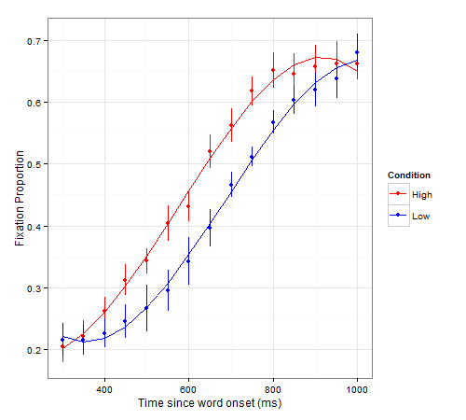
Visualizing growth curve models
ggplot2 is the best way: see example code from https://www.danmirman.org/gca

Slide 20
Preparing for end of course
Complete final practical exercises
Prepare and show up for Exam Q & A session (next week)
Keep an eye on Canvas for Exam Study Guide (prior to Q&A session)

Slide 21

Thanks! Questions?
Material from Mirman Tutorial and here

